Slide 1

Data Visualization
Visualizing the variable from Dataset of AirBnB listings in major U.S. cities

Slide 2
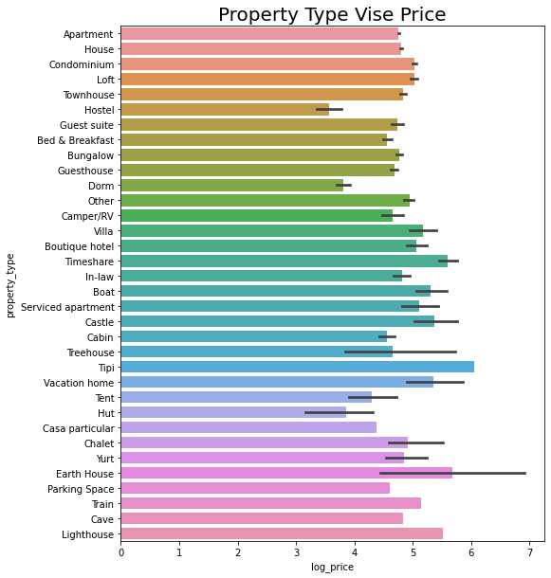
Prices of the Different Property Types
This graph shows variation of the price of each property type which are associated with AirBnB.
From the above plot we can depict that the price for the property type "Tipi" is "Highest" and the price for "Hostel" are lowest

Slide 3
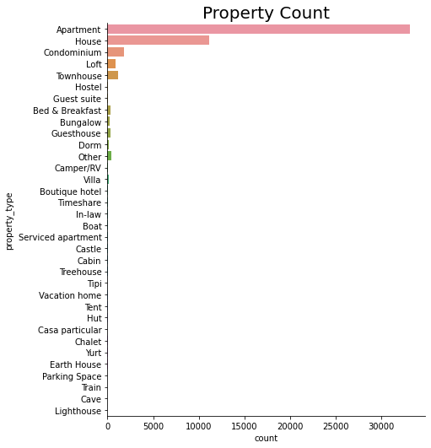
Count of each Property Type
This graph shows that count of each property type.
"Appartment" are highest, followed by “House” and the number of “Parking Space”, ”Train”, "Cave", "Lighthouse" are the least.

Slide 4
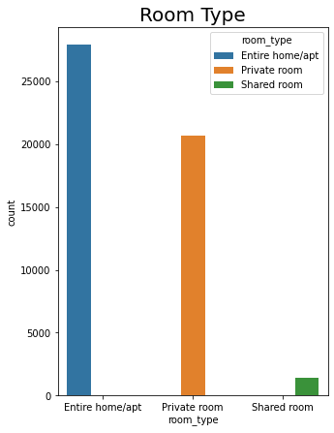
Room Types
This graph shows that most of the Air-BnB properties is US are with "Entire home/apt" or "Private room" room types.

Slide 5
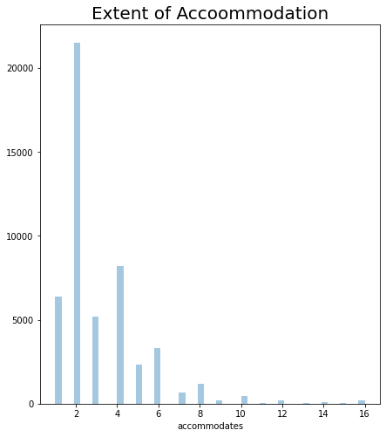
Accommodation Capacity
This graph categories the count of properties on the basis of their Accommodation Capacity.
We can see that most of the properties can accommodate 2 or 4 members, followed by 1 and 3 members

Slide 6
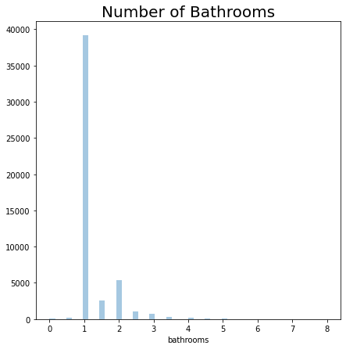
Number of Bathrooms
This graph categories the count of properties on the basis of the number of bathrooms present within them.
We can clearly see that most of the properties are with 1 bathroom

Slide 7
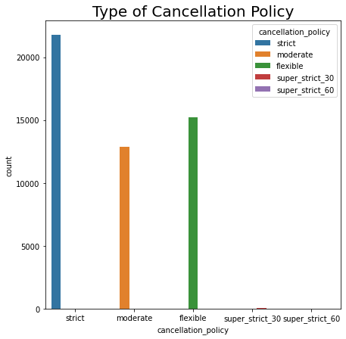
Severity of Cancellation Policy
This graph show that the properties with "Strict Cancellation Policy" are highest in numbers
Where as the number of properties with "Moderate" and "Flexible" Cancellation Policies are also considerable

Slide 8
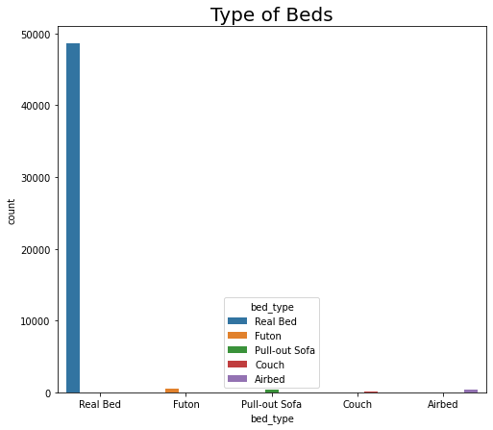
Bed Types
This graph shows that nearly most of the "Bed" provided in the properties are the "Real Beds"

Slide 9
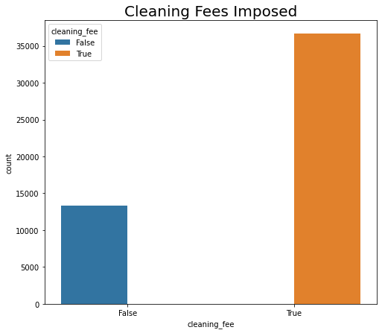
Cleaning Fee
This graph depicts that in most of the properties the "Cleaning Fee" is charged

Slide 10
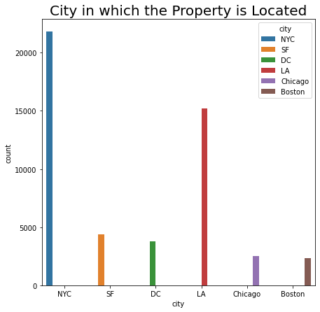
City of the Properties
This graph shows the density of the properties in the different cities of US
It clearly depicts that the properties of AirBnB are mostly present in "NYC" followed by "LA",
This plot can really help a visitor who is not a frequent traveler

Slide 11
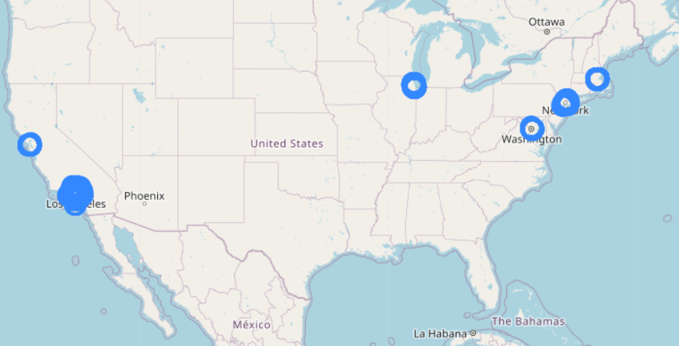
This map show the geographical representation of the last graph (City in which the Property is Located)
Here the density of the properties are marked by Circles

Slide 12
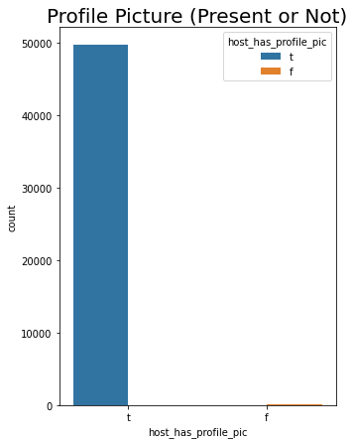
Profile Picture
This graph shows that mostly the "Profile Picture" are present on all the properties, which will give a good idea of the properties to the visitors

Slide 13
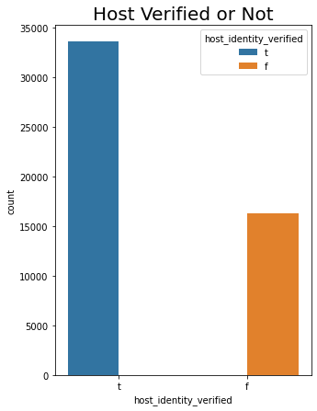
Host Identity Verified or Not
This graph shows that nearly 2/3 of the hosts are verified and approximately 1/3 of the hosts are still not verified

Slide 14
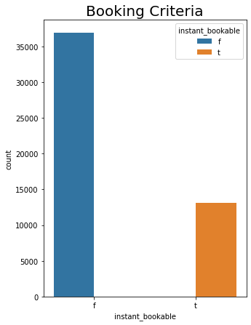
Booking Criteria
This graph shows, if the properties have the instant booking available or not
Most of the properties have the facility of Instant Booking

Slide 15
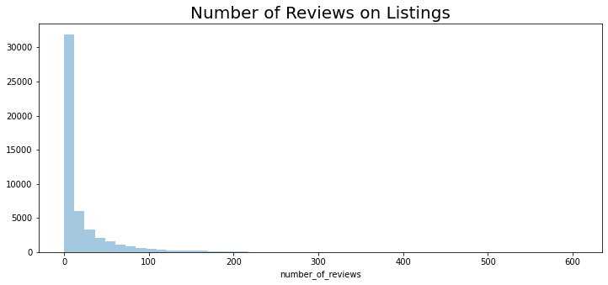
Number of Reviews
We can see that "Number of Reviews" present on the listings are mostly within the range of "0-100"

Slide 16
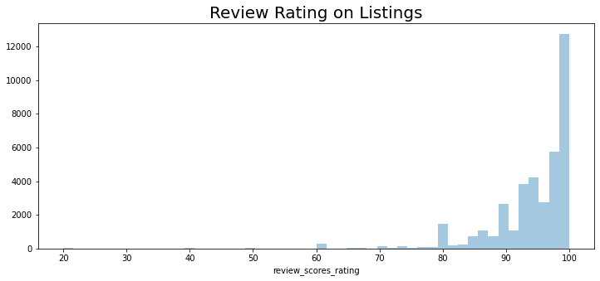
Review Rating
This graph shows that most of the "Ratings“ of the properties are between 90-100.
Which is a good sign for brand

Slide 17
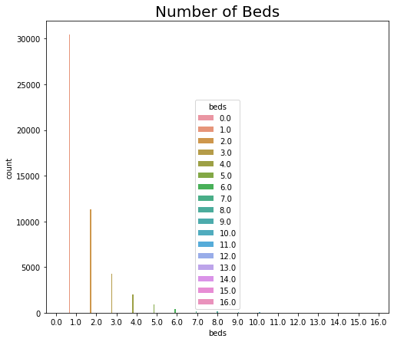
Bedrooms
1 "Bedroom" is present in most of the properties

Slide 18
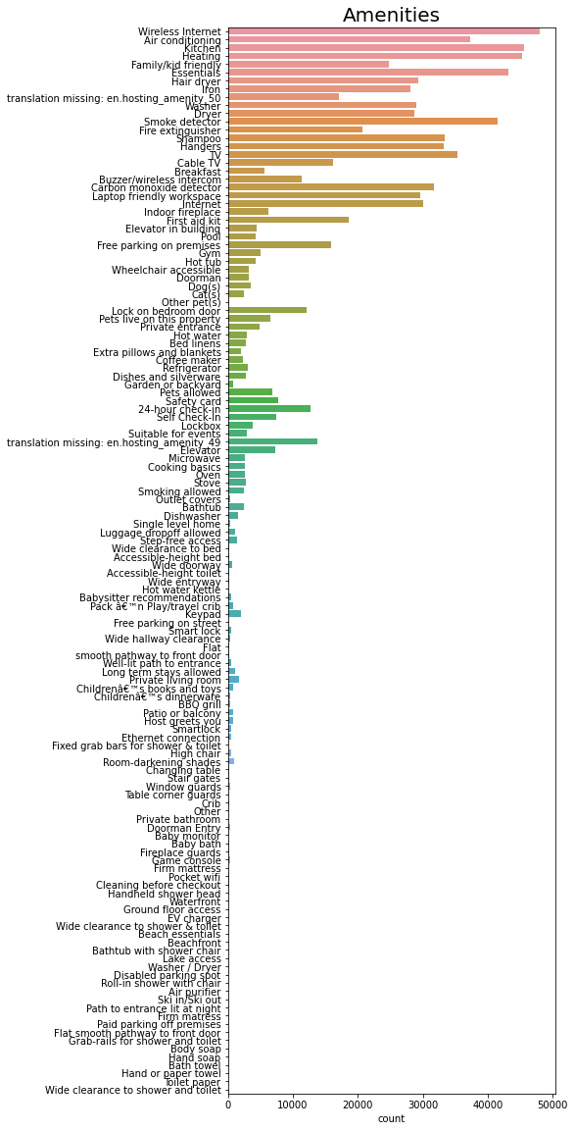
Amenities
This graph shows the amenities present in the AirBnB properties
It can be clearly depicted that essential amenities like "Wireless Internet, Kitchen, Heating, Air Conditioning, Essentials, Smoke Detector, TV, Buzzer, etc." are provided in most of the AirBnB properties in US

Slide 19
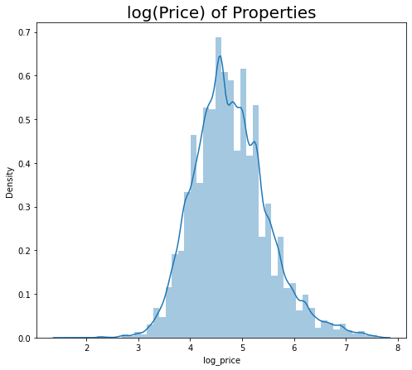
Price of the Properties
This graph depicts the trends of log(price) of the properties
The Property Prices are primarily diversified between 4-6

